Slide 1


Department of ECE
College of Engineering Guindy, Anna University, Chennai
EC5712 – Project I
Presentation
25.11.2024
AUDIO WATERMARKING FOR COPYRIGHTS
Project Members:
Saravanan D (Reg. No.:2021105047)
Ashwin S (Reg. No.:2021105005)
Sindhu S U (Reg. No.:2021105050)
Under the Guidance of:
Dr. K. Gunaseelan
Professor
Department of ECE
CEG Campus, Anna University

Slide 2

Layout
Introduction
Project Motivation
Literature Review
Inferences from the literature
Project Objectives
Proposed Methodology
Results and Discussion
Conclusion & Future Work
References

Slide 3
Introduction
Protect an audio signal by encrypting it with a watermark and ensure that it’s transmission and reception is protected.
Audio watermarking detect illegal reproduction and redistribution of audio recordings.
Watermarking or Steganography embeds machine readable information like copyright within the data of the signal.
It must be inaudible within the host audio and should be to not destroy/alter the data within the signal.

Slide 4
Project Motivation
Balance between robustness against various attacks and the preservation of audio quality.
Frequency Watermarking to embed image bit into the audio signal.
Psychoacoustic models, enabling the watermark to be embedded in less perceptible parts of the audio signal.
Robustness against attacks such as compression, noise addition, and filtering.

Slide 5
Literature Review
Literature Review
Ref. No. | Publication Details | Methodology | Inference
[1] | An Audio Watermarking Algorithm Based on Fast Fourier Transform Xiumei Wen, Xuejun Ding, et al, IEEE journal on signal processing | Utilizes Fast Fourier Transform (FFT) to embed watermarking information into the phase coefficients of the audio signal. Employs a demodulation process with BCH coding to retrieve the watermark | SNR comparable to that of the non watermark embedded audio is obtained which indicates that the watermarking process did not significantly alter the quality of the original audio signal, maintaining a high level of inaudibility
[2] | A Blind Audio Watermarl(ing Algorithm Based on FFT CoefficientsQuantization Yubao Bai, Sen Bai et al, International Conference on Artificial Intelligence and Education ,2019 | The audio signal is divided into segments, and each segment undergoes Fast Fourier Transform (FFT) to convert it into the frequency domain. The DC coefficients from the FFT results, which carry the watermark information, are selected. A predefined formula checks the DC coefficients against a threshold to extract the watermark. | The watermark remains intact (almost 0% BER) under most conditions, with increased BER only at lower compression rates (64kbps, 48kbps, 32kbps). The method shows strong adaptability to various audio processing attacks, maintaining audio quality while ensuring watermark integrity.

Slide 6
Literature Review
Literature Review <Two papers per slide>
Ref. No. | Publication Details | Methodology | Inference
[3] | A Literature Survey – Various Audio Watermarking Techniques and their challenges Jaya Bajpai et al IEEE journal on signal and image processing,2017 | FFT utilized to embed watermark information into the phase coefficients of the audio signal. Watermark Intensity α, set at 0.1 to ensure minimal distortion. | Strong robustness against various signal processing attacks is achieved. The watermark extraction process yields clean and identifiable results
[4] | Haruka Sakai et al., "Audio Watermarking MethodBased on Phase-shifting Having Robustness Against Band-Pass Filtering Attacks," IEEE, 2021 | The embedding process involving calculation amplitude spectrum of audio frames, identifying the maximum amplitude frequency and embed binary information. | Improve robustness of audio watermarking against band-pass filtering (BPF) attacks and maintains the audio quality

Slide 7
Inferences from the literature
Achieving high PSNR and NC values indicates that audio watermarking methods can effectively balance robustness.
High watermark capacity and SNR means obtaining minimal BER, ensuring imperceptibility.
Psychoacoustic models enhances imperceptibility without compromising robustness.

Slide 8
Project Objectives
Robustness Against Attacks: Enhance the robustness of the watermark against various attacks such as compression, noise addition, and filtering by embedding it in the frequency domain, where audio signals are generally more stable.
Maintain Audio Quality: original audio quality is preserved after embedding by controlling the amount of alteration to the frequency components.
Achieve high detection rates ensuring that the watermark can be reliably extracted when needed.
Aim to reduce the perceptibility of watermark by targeting frequency ranges that are less audible to the listener.

Slide 9
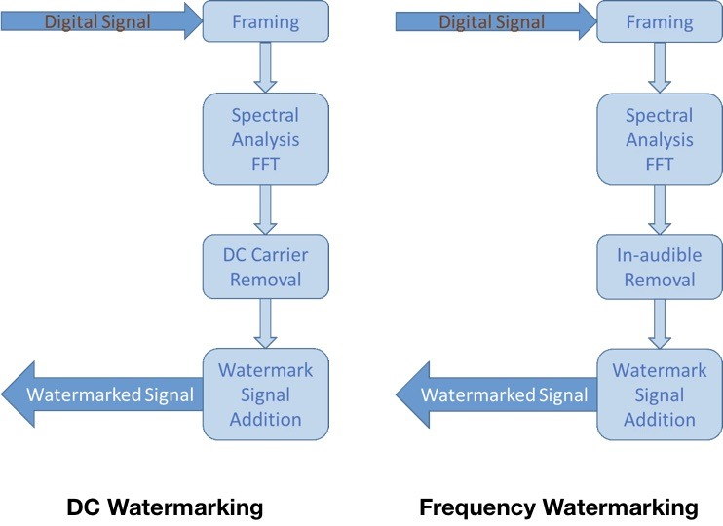
Methodology
Frequency Watermarking:
Find out a frequency band loud enough while the frequency near it are rather quiet. Therefore, we replace the frequency band with low magnitude to our information to make the watermark.

Slide 10
Methodology
Software Required: MATLAB
Divide audio into frames and process each frame.
Compute FFT of the frame.
Calculate masking threshold using psychoacoustic model
Extract pixels from the image to be embedded.
Modify frequency components below masking threshold to embed image data using frequency watermarking
Apply inverse FFT to get watermarked audio frame.
Reverse process to Extract the Copyright information

Slide 11
Methodology
Psycoacoustic model: The Bark scale is a psycoacoustic model of the human perception of loudness in relation to frequency.
In designing watermarks, algorithms can apply masking thresholds that consider the Bark scale to determine which frequencies can effectively hide or distort information without being perceptible.
Zi - Current frequency's threshold
Zk - Peak threshold
dz = zi – zk

Slide 12
Methodology
In the process of watermark embedding, Spreading Function is used as a model for defining how energy or information in one frequency band affects neighboring frequency bands.
Spreading Function Regions:
Region 1: -3 <= dz < -1
Region 2: -1 <= dz < 0
Region 3: 0 <= dz < 1
Region 4: 1 <= dz < 8
The range of -3 to 8 in the masking function serves to define the region in which the masking effects of louder sounds on quieter sounds are most significant.
Region 3 (0 dB to 1 dB):
When the current frequency is nearly equal to the peak amplitude (0 dB difference), the masking effect can significantly suppress quieter sounds. The adjustments in this region are typically more substantial since the influence of loud sounds is at its peak

Slide 13
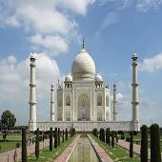
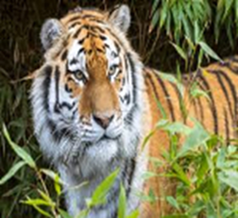
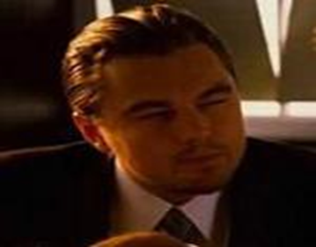
Results and Discussions
IMAGE 1 | IMAGE 2 | IMAGE3

Slide 14


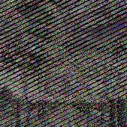
Results and Discussions
Audio | AUDIO 1 (High Amplitude) | AUDIO 2 (Mid Amplitude) | AUDIO 3 (Low Amplitude)
Original Image Quality

Slide 15
Results and Discussions
The system experienced noise issues caused by changes in image dimensions during the watermark setting and extraction process.
To address this, adaptive changes in dimensions were implemented to align with the original and extracted images.
Additionally, the audio signal's characteristics require specific peaks to maintain an effective spreading function within the range of -3 to 8. These peaks are essential for robust psychoacoustic masking, ensuring the watermark remains imperceptible while embedded

Slide 16
Results and Discussions
Comparison table between different audios and images combinations:
Normalized Correlation(for audio quality):
 | AUDIO 1 | AUDIO 2 | AUDIO 3
LEO | 0.9983 | 0.9992 | 0.9988
TIGER | 0.9984 | 0.9993 | 0.9988
TAJMAHAL | 0.9976 | 0.9990 | 0.9982
PSNR Values(for image quality):
 | AUDIO 1 | AUDIO 2 | AUDIO 3
LEO | 44.94 | 44.25 | 13.71
TIGER | 28.92 | 28.99 | 9.25
TAJMAHAL | 31.21 | 32.42 | 7.79

Slide 17
Results and Discussions
Normalized correlation standardizes or scales the correlation by removing the influence of the signals' amplitudes, focusing only on their structural similarity.
+1 for perfect positive correlation
0 for no correlation
-1 for perfect negative correlation
PSNR is expressed in decibels (dB), with higher values indicating a closer match to the original and higher quality.
Higher PSNR (e.g., > 30 dB): Indicates high quality, meaning the processed image or signal is very similar to the original.
Lower PSNR (e.g., < 20 dB): Indicates significant loss in quality,noticeable distortions.

Slide 18
Future Work
Robustness: Enhance resistance to various distortions like compression and noise, ensuring watermark durabilityfor different images
Scalability: Improve methods to handle different audio datasets and diverse content types effectively.

Slide 19
Conclusion
Objective: Embed image data into audio, imperceptible to human hearing.
Read audio and image, divide audio into frames, apply FFT, calculate psychoacoustic masking threshold.
Embed image bits into frequency components below masking threshold.
Using frequency watermarking embed pixels into audio and Inverse FFT to reconstruct watermarked audio.
Extraction: Reverse process to recover hidden image.

Slide 20
References
Irma Safitri et al. “Adaptive multilevel wavelet BCH code method inthe audio watermarking system”, IEEE Journal, 2017
Keqiang Ren et al. “Large Capacity Digital Audio WatermarkingAlgorithm Based on DWT and DCT”, IEEE, 2020
Arashdeep Kaur et al. “A blind audio watermarking algorithm robust against synchronization attacks”, IEEE Journal, 2020
Bailong Yang et al., “Lossless and Secure Watermarking Scheme in MP3 Audio by Modifying Redundant Bit in the Frames , 2023
Chen Xuesonget al. “A dual digital audio watermarking algorithm based on LWT”, IEEE JOURNAL, 2018
Haruka Sakai et al., “Audio Watermarking MethodBased on Phase-shifting Having Robustness Against Band-Pass Filtering Attacks,” IEEE, 2021
Yong Xiang et al., “Spread Spectrum-Based High Embedding Capacity Watermarking Method for Audio Signals,” IEEE , 2017
Rozan Nauf Firmansyah et al., “ Adaptive Segmentation on Audio Watermarking using Signal Differential Concept and Multibit Spread Spectrum Technique”

